Slide 1

Gathering requirements for your star schema
How you can collaboratively design a dimensional model with your business users
Johnny Winter

Slide 2


ABOUT ME

Slide 3



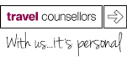



Slide 4

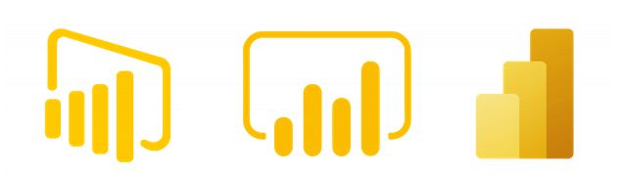

Slide 5
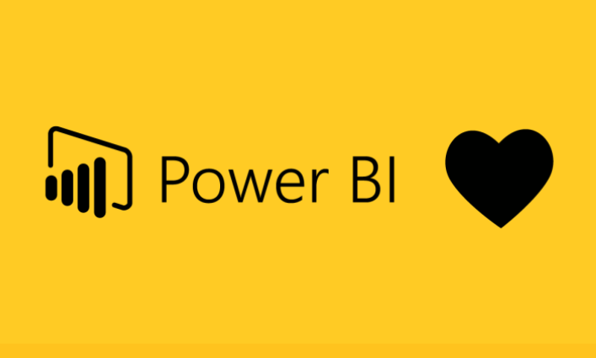
I love power BI

Slide 6
Why are we here?

Slide 7


Slide 8


Slide 9
The relevance of star schema

Slide 10

“Power BI is a model centric tool”
- Jeffrey Wang

Slide 11
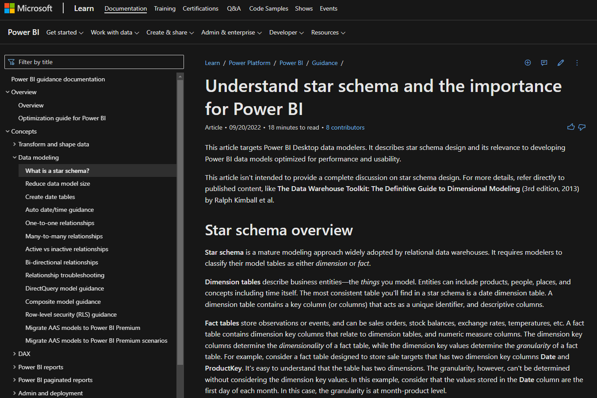
IMPORTANCE OF STAR SCHEMA
https://learn.microsoft.com/en-us/power-bi/guidance/star-schema

Slide 12
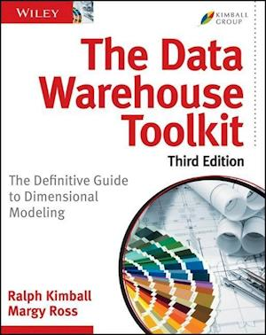
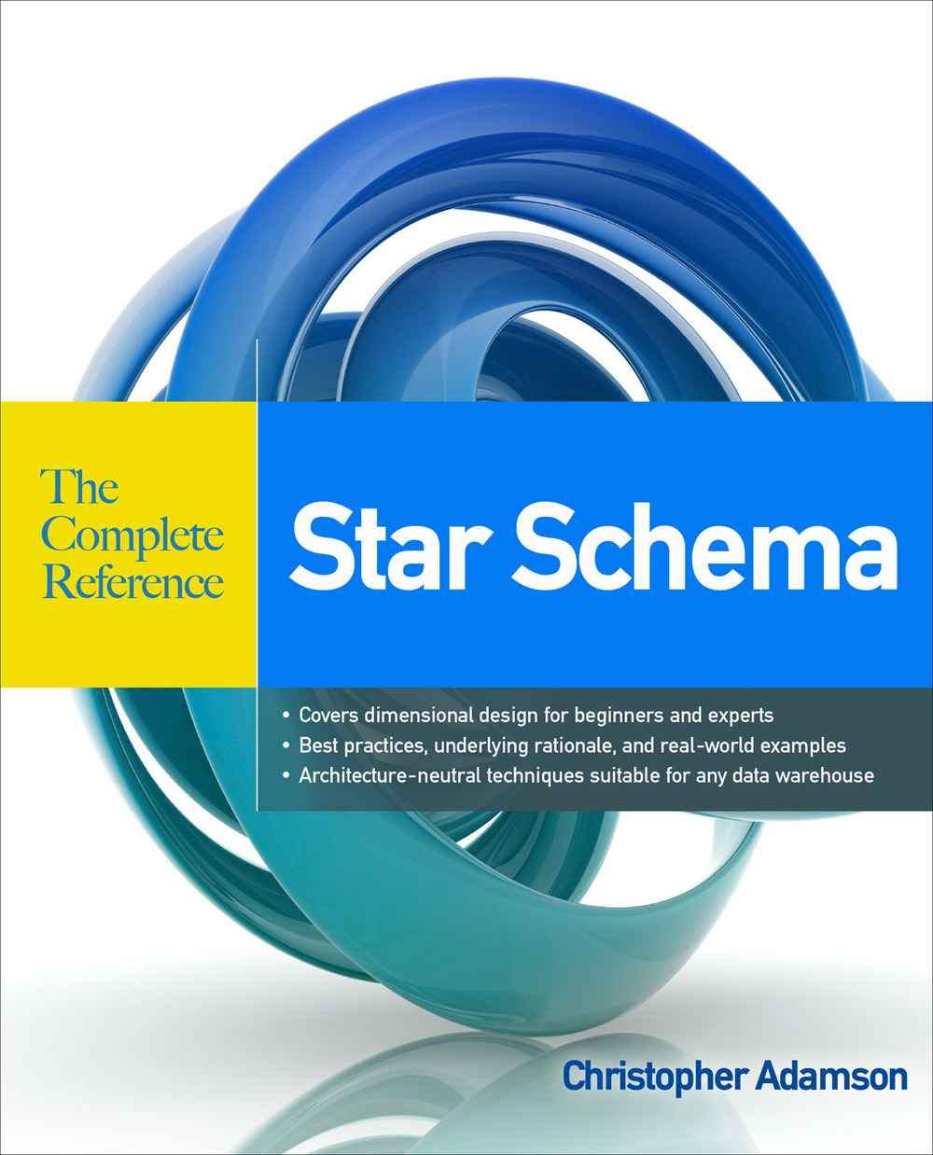
What is a star schema?

Slide 13

ROCHE’S MAXIM
“Data should be transformed as far upstream as possible, and as far downstream as necessary.”
- Matthew Roche

Slide 14

“The success of the data platform is dependent on the data model built within it”
- James Bell

Slide 15
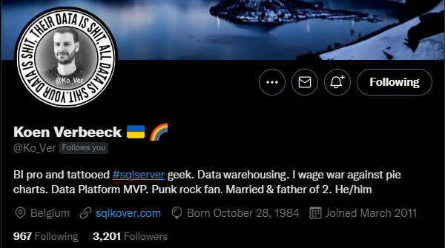
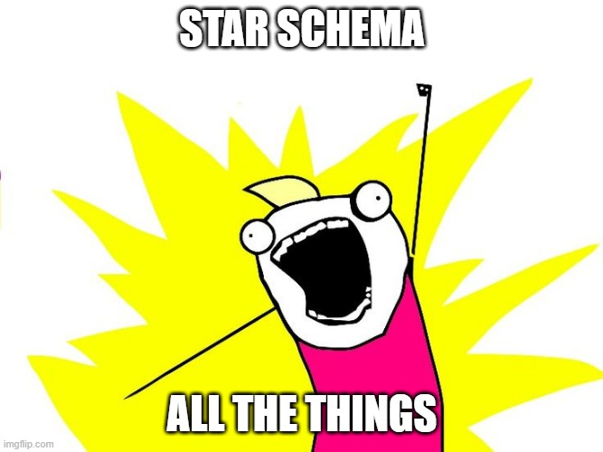

Slide 16





The problem with people
Developers
Very technical
Can write code
Understand the tech
Business users
Understand the business
Know what they want to see
Not always great at explaining what they need

Slide 17
Requirements gathering PROCESS

Slide 18

sunbeam

Slide 19
DATA MODELLING TOOLS & TECHNIQUES
BEAM*
SUN MODELLING

Slide 20
Beam*

Slide 21
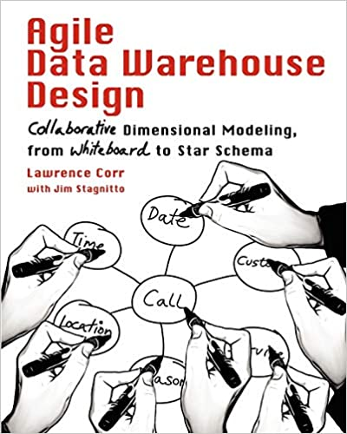
BEAM*
Agile Data Warehouse Design by Lawrence Corr
Business Event Analysis & Modelling
3 Ds
7 Ws

Slide 22
SUN MODELLING

Slide 23

Sun modelling
Word of mouth technique
Advocates of Sun Modelling
Emma Zambonini
Pete Moore
Terry McCann
Mark Whitehorn
Professor of Analytics at the University of Dundee

Slide 24
TYPES OF DATA MODEL
User model
Physical model
Logical model

Slide 25
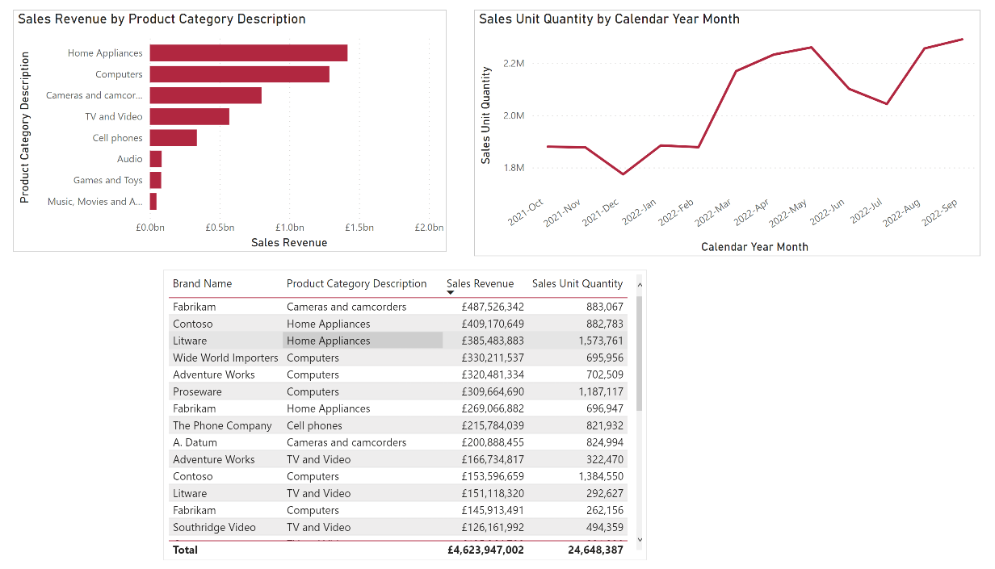
User model

Slide 26
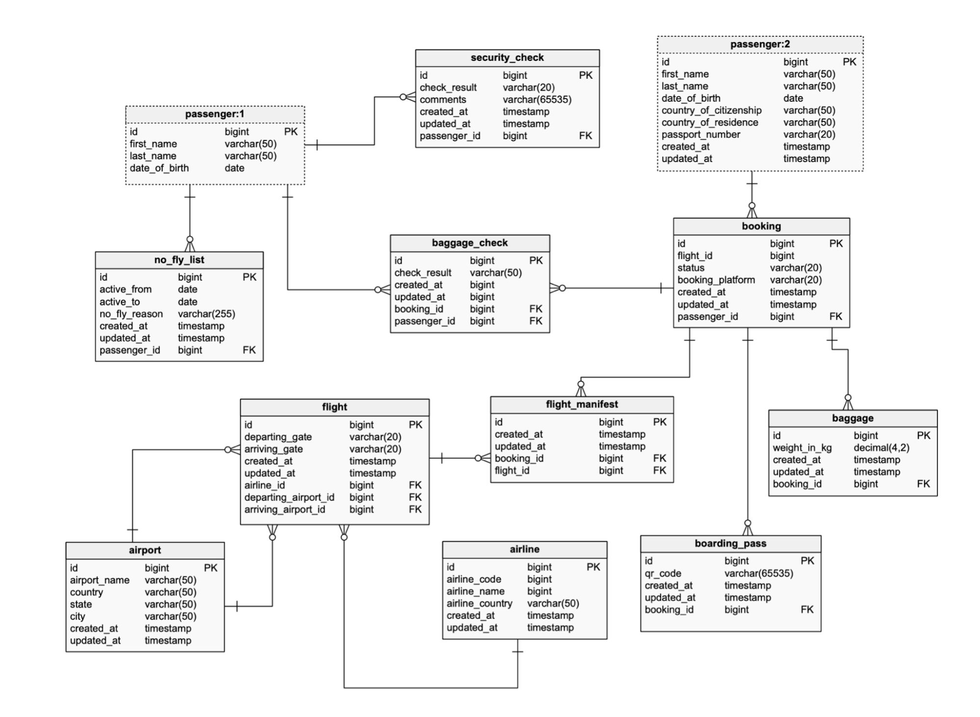
Physical model

Slide 27
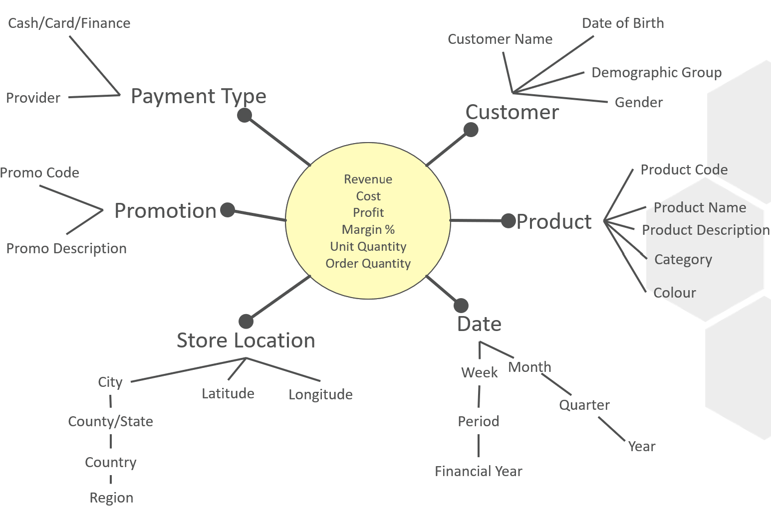
Logical model

Slide 28
Running a workshop

Slide 29




Hold A workshop
Miro
Mural
MS Whiteboard

Slide 30
WHO TO INVITE?
Get your business users involved
Good to have 2 people running the workshop. One facilitator, one scribe.
Choose one business process
Invite 3-5 people with domain knowledge

Slide 31
The 3 ds

Slide 32
The 3 Ds
Discover an event
“who does what?
Describe an event
USE THE 7 Ws
Document an event
SUN MODELLING

Slide 33
discover

Slide 34
WHO DOES WHAT?

Slide 35
DESCRIbe

Slide 36
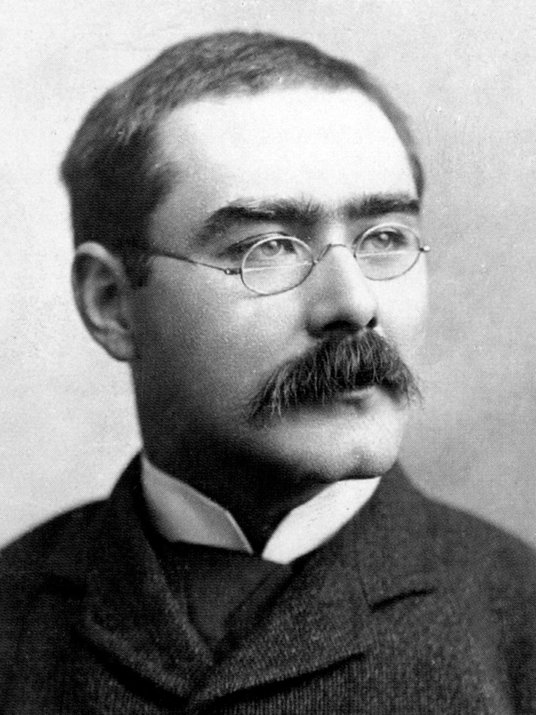
“I keep six honest serving men (they taught me all I knew); Their names are What and Why and When and How and Where and Who”
- Rudyard Kipling

Slide 37
7W s
Who?
What?
When?
Where?
Why?
How?
How many?

Slide 38
DOCUMENT

Slide 39
WHO DOES WHAT?
Customer buys product
Cash/Card/Finance
Date of Birth
Customer Name
HOW MANY
Demographic Group
Provider
Payment Type
Customer
Gender
WHO
Revenue
Cost
Profit
Margin %
Unit Quantity
Order Quantity
WHAT
Promo Code
Product Code
Promotion
Product Name
WHEN
Product
Product Description
Promo Description
Category
WHERE
Colour
WHY
Date
Store Location
HOW
Month
City
Week
Latitude
Longitude
Quarter
County/State
Period
Year
Country
Financial Year
Region

Slide 40
Tips and advice
Ask the 7Ws multiple times – often there is more than one answer
…but for some Ws there may be no answers
One sun model per event
Hold multiple workshops if necessary
You can do this before data discovery if you like
Don’t get bogged down in what you already know about your data
You may wish to use your logical model to go away and design a physical model
But this isn’t the finished/fixed design – it’s a target, but may change during implementation
You can consolidate multiple sun models in to a Bus Matrix

Slide 41
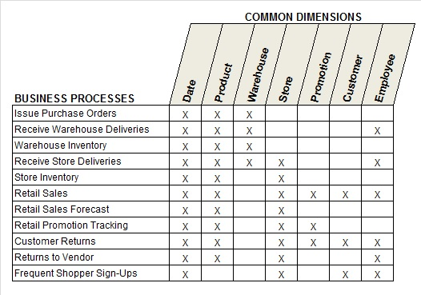

Slide 42
GaPS
Assumes one-to-many relationships.
Design doesn’t cover things like bridge tables
Doesn’t cover dimension types.
This tends to come out during implementation

Slide 43

MAKE IT YOUR OWN!

Slide 44
Questions?

Slide 45
Thank you!

